Slide 1
Upscaling Basic Sanitation for the Urban Poor (UBSUP)
Background information needed for the Site Selection
for a DTF

Slide 2
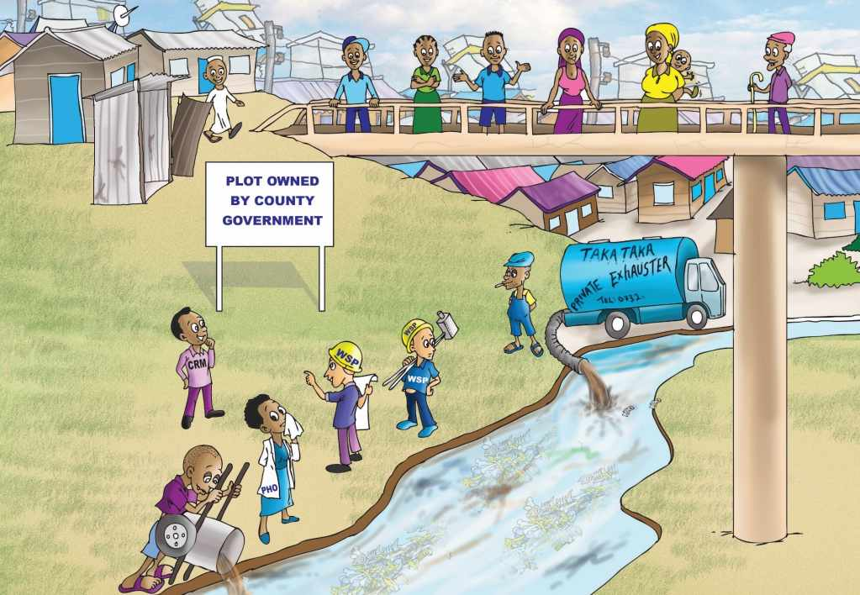
Objective: You are able to identify the correct site for your DTF

Slide 3
Content
Questions you might to ask yourself:
What is the context of this session?
Why is it a big deal to select a site?
Who selects the site?
What needs to be considered?
Is there any support in selecting a site?

Slide 4
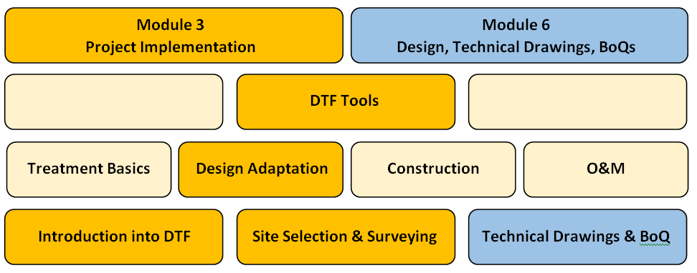
What is the context of this session?
The SafiSan Toolkit
all info can be found in your manual

Slide 5
Why is it a big deal to select a site?
WSTF only approves a site for a DTF if 7 criteria a met:
Overall criteria:
Enhances public health conditions in the project area
Closes the sanitation value chain by treating human excreta to allow its reuse in a safe manner
Treats human excreta generated in urban LIAs where it is located or areas in its vicinity
Technical criteria
are mentioned on the next slide

Slide 6
Why is it a big deal to select a site?
Technical criteria:
The DTF treats matter generated in UDDTs in order to ensure complete stabilisation and safe reuse
The DTF treats FS that is exhausted from latrines and septic tanks that exist within the catchment area of the DTF
The DTF ensures small per capita investment; hence sewer-based treatment of WW is not foreseen
The standardised DTF treats approx. 22m³ of FS per day and/or matter generated from approximately 250 UDDTs

Slide 7
Who selects the site?
The site is selected by your DTF Technical Team
In collaboration with relevant stakeholders:
County Official
County Resident Monitor (CRM)
NEMA and WRMA
PHO
Chiefs, elders and residents
Supported by staff and “Flying Squad” of the WSTF

Slide 8
Who selects the site?
Composition of the DTF Technical Team:
Team should be set up within the WSP “Project Task Team (PTT)“
Core team should have 3-4 participants, incl. Technical Manager
The composition of the DTF Technical Team should not change (staff for supervision and O&M should participate from beginning)
If required, external consultants should be hired by the WSP

Slide 9
Who selects the site?
Required skills within the DTF Technical Team:
Taking levels with a levelling device (surveying skills)
Preparing technical drawings (architectural and structural)
Preparing BoQs
Construction supervision at site
Basic knowledge on WW/FS treatment mechanisms is obligatory

Slide 10
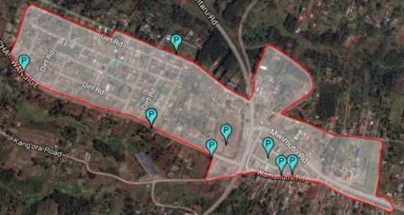
What needs to be considered?
A holistic view on a potential site for a DTF is required
Even small details can make a DTF project fail
A potential site needs to be analysed thoroughly with certain considerations in mind....
?

Slide 11
What needs to be considered?
Group Exercise “Site selection criteria”:
Please arrange 5 company-internal working groups
Kindly brainstorm within your group (15 minutes) which factors might be relevant for the selection of an appropriate DTF site, and why these factors are important
Please present your findings (5 minutes) to the plenary

Slide 12
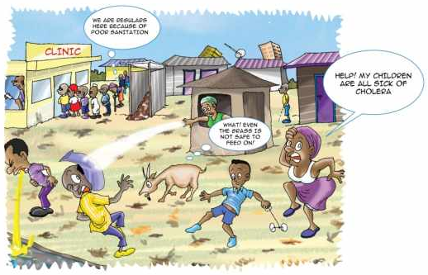
Will the DTF serve the target group?
DTFs primarily serve inhabitants of LIA
Higher income area can benefit as long as focus is on urban poor
Build DTF close to LIA where FS / UDDT matter is generated
Short transport distances
Avoid resistance from other areas that do not benefit

Slide 13
Is the DTF required to treat excreta?
Investment and O&M costs only pay off if a minimum quantity of FS and/or UDDT matter is treated
WSP exhausters must really discharge into the DTF
If no WSP exhausters: private exhausters will use it, otherwise FS treatment is not required (illegal dumping to be stopped with NEMA)
Future demand needs to be assessed together with the County to ensure that demand does not decrease (e.g. construction of a sewer system)
Autonomous developments to be considered, e.g. whether a LIA converts into a higher income area in close future

Slide 14
Will the DTF “products” being used?
Clarify where the treated effluent, dried sludge and compost is deposited and/or reused
More beneficial if the end products are used : effluent for irrigation, dried sludge as soil conditioner, compost as fertilizer (► close the sanitation value chain)
If reuse is not feasible, a more beneficial site should be considered
Even without reuse, site might be okay as main objective is to improve public health

Slide 15
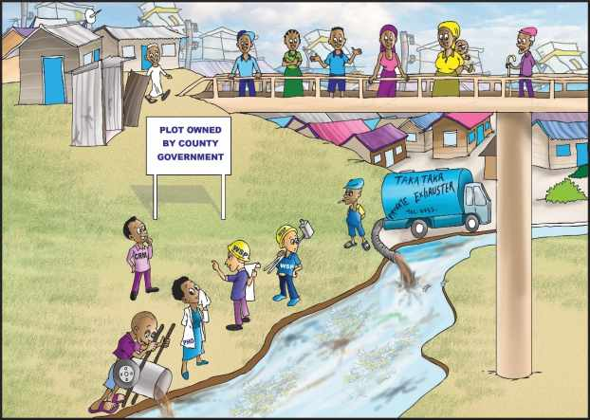
Is land available?
Land availability and evidence of official documents need to be proven to ensure that all the legal steps have been carried out

Slide 16
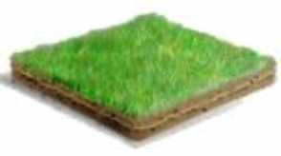
Is land available?
1. Assure proper land is available for construction and operations
Public land is preferred; if the land is provided by the County, an official and written permission should be obtained
If bought from a private person, a title deed must be obtained in the name of your company
2. Assure that ...
Required stakeholder are involved during site selection and verification
Required approvals are obtained in time

Slide 17
Is space available?
Total surface area: Do all required DTF modules fit on the grounds?
Layout and characteristics of the area: Is it possible to arrange the different modules in a logical / operational manner?
DTF module | Length [m] | Width [m] | Footprint [m²]
Receiving Bay / Balancing Tank (RB/BT) | 6 | 9 | 54
Settler (ST) | 8 | 4 | 32
Anaerobic Baffled Reactor (ABR) / BT | 11 | 4 | 44
Vertical Flow Constructed Wetland (VFCW) | 11 | 30 | 330
Sludge Drying Reed Bed (SDRB) | 19 | 11 | 209
Co-composting Area (CA) | 10 | 8 | 80
+ Space for an operator/storage building, between the modules, (bypass) piping, inspection boxes, manoeuvring exhauster
► Total footprint is about 1,000-1,500 m². If only a CA is required, space requirement is 160 m².

Slide 18
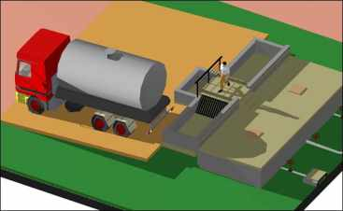
How can the DTF being reached?
Access to your DTF is of utmost importance, otherwise it is uneconomic and DTF will not be approached:
Distance for exhausters max. ~10km (septic tanks, latrines)
Distance SaniGo or other transport means max. ~ 5km (UDDT)
Accessible by road
Slope to and within the DTF appropriate for exhausters and manual means of transport

Slide 19
Which role play slope and levels?
Level differences within the DTF modules:
DTF module | Difference [m] | Remark
ST | 0.10 | Between inlet and outlet pipe
ABR | 0.15 | Between inlet and outlet pipe
Siphon/BT | 0.85 | Between ABR outlet and outlet of BT attached to ABR (for intermittent loading of VFCW)
VFCW | 0.70 | Between feeding and drainage pipe
Slope within the pipe network:
Between BT outlet and ST inlet: 1%
Between ST outlet and ABR inlet: 1%
Between ABR outlet and VFCW inlet: 1%
Between VFCW outlet and final discharge point: 0.5-1.0%

Slide 20
Which role play slope and levels?
Total level difference within DTF:
Within treatment modules: 1.80m
Within network: 0.7m (based on 6m between modules, 50m to river)
Total level difference: ~ 2.5m (equivalent ~ 2% slope)
► If distance between modules reduce, required slope of terrain reduces
► Level of all treatment modules depends on level of final effluent discharge (e.g. flooding level of river)
Receiving Bay
Δh
River

Slide 21
What is the final effluent discharge point?
Discharge points refers to effluent of VFCW (treated FS/WW)
► Nearby River (flooding level) - preferred
► Existing drainage channel / trench
Point should be max. 100m from VFCW outlet
Inspection chambers to be placed every 20-25m for cleaning of clogging

Slide 22
Which role plays solid waste?
Well sorted organic waste is required for co-composting:
Bio-waste to be mixed 3:1 with UDDT matter in the CA
Collected from LIA or markets
Transported by SaniGo or existing solid waste collectors

Slide 23
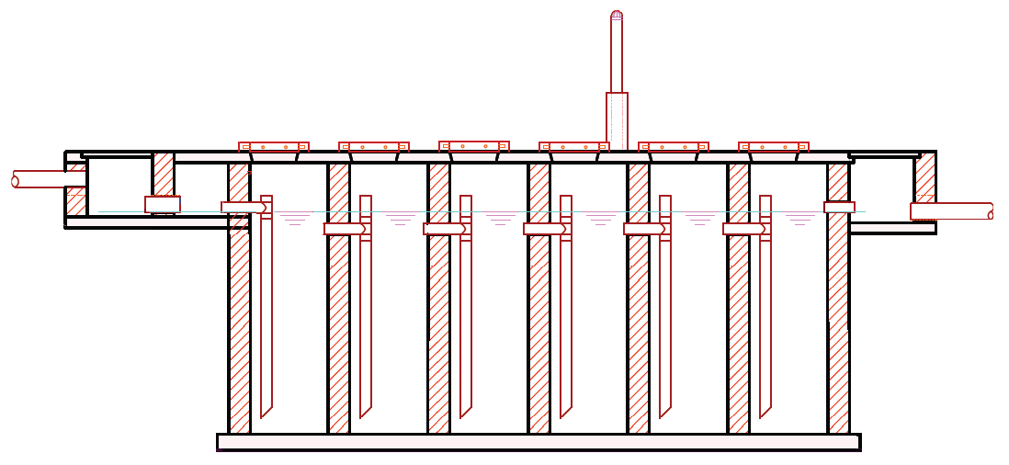
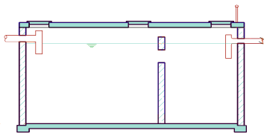
Which role play soil conditions?
Soil conditions play a role during construction and related costing
Type of soil: hard rock / soft soil → excavation cost; black cotton → deeper excavation until hard bed; clay → used for lining of VFCW
Groundwater level: → pumping during excavation/construction; → special waterproofing might become necessary
Soil moisture: wetland or flooding area → relocate pipes / modules

Slide 24
Who will build the DTF?
Your WSP needs to outsource construction to a contractor
Construction quality is crucial to guarantee proper operations
Reliable and capable contractor required
Trained artisans, technically qualified staff
Required equipment (e.g. concrete mixer, form works, dumpy level)
Proven experience in comparable projects
References and reputation
Rigorous/permanent supervision by WSP is required

Slide 25
Is the DTF affordable?
Affordable: Revenues > Expenses:
Expenses:
O&M cost: incl. operator, energy, preventative and corrective maintenance, repairs
Incentive for Sanitation Teams to dispose of UDDT matter
Revenues:
Cost saving for unloading WSP exhausters into DTF
Fee charged from private exhauster services (► law enforcement to avoid illegal dumping)
Tariff increase approved by WASREB for improved service delivery
Sales of compost and soil conditioner

Slide 26
Is there any support in selecting a site?
Decision matrix to check...
Whether a site is generally feasible for a DTF
Which treatment trains are required
Tool for baseline data collection and field survey, incl. various templates
Stakeholder analysis to explain roles and responsibilities of relevant actors
Workflow chart to showcase which steps need to be taken and which stakeholder are to be involved at what point
All tools are explained and tested within the course of this training

Slide 27
Do you have any questions, remarks or suggestions?

